Slide 1

API and Data Collection

Slide 2

PPT下载 http://www.1ppt.com/xiazai/
CONTENTS
PART ONE
PART TWO
PART THREE
01
02
03
Get XHS API
Use XHS API
ZHIHU Data

Slide 3


How to get XHS API
PART ONE
Notes:
模板来自于：第一PPT https://www.1ppt.com/

Slide 4

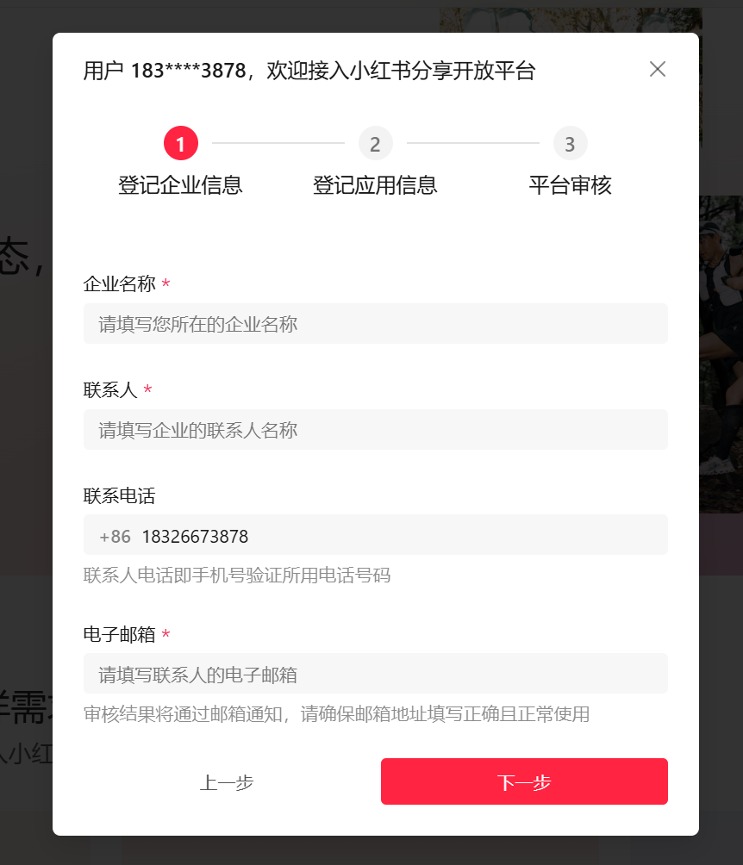
01.Get API
小红书分享开放平台：https://agora.xiaohongshu.com/index
Need to have a company to apply for API

Slide 5
USE XHS API
PART TWO

Slide 6
02.USE API for posts
Retrieving User Posts: You can get a list of posts made by a specific user. This includes accessing the content of each post, such as text, images, and videos.
Fetching Post Details: For any given post, you can retrieve detailed information such as the post content, number of likes, comment, shares, and other engagement metrics.
Searching for Posts: The API can be used to search for posts based on specific keywords, hashtags, or topics. This helps in discovering content related to particular themes or interests.
Accessing Trending and Recommended Posts: You can get a list of trending posts or posts recommended by the platform, which can be useful for understanding current popular content.
Comment and Like Data: The API allows you to fetch comments and likes associated with posts, providing insights into user interactions and engagement.

Slide 7
02.Use API for other purposes
User Data Retrieval:
Access basic user information such as user ID, nickname, and profile picture.
Retrieve lists of followers and followings for a user.
Get a user’s list of notes (posts) and their details.
2. Content Publishing and Management
Publish new notes (posts), including text, images, and videos.
Update or delete existing notes.
Retrieve comments and like data for notes.
3. Search and Discovery
Search for notes, users, topics, and relevant search results.
Access trending topics and recommended content.
4. Data Analysis and Statistics
Obtain statistics on notes such as views, likes, favorites, and comments.
Analyze user behavior and content popularity.
5. Advertising and Marketing
Manage ad companies and monitor their performance.
Access analytical data related to advertisements.

Slide 8
ZHIHU Data
PART THREE

Slide 9
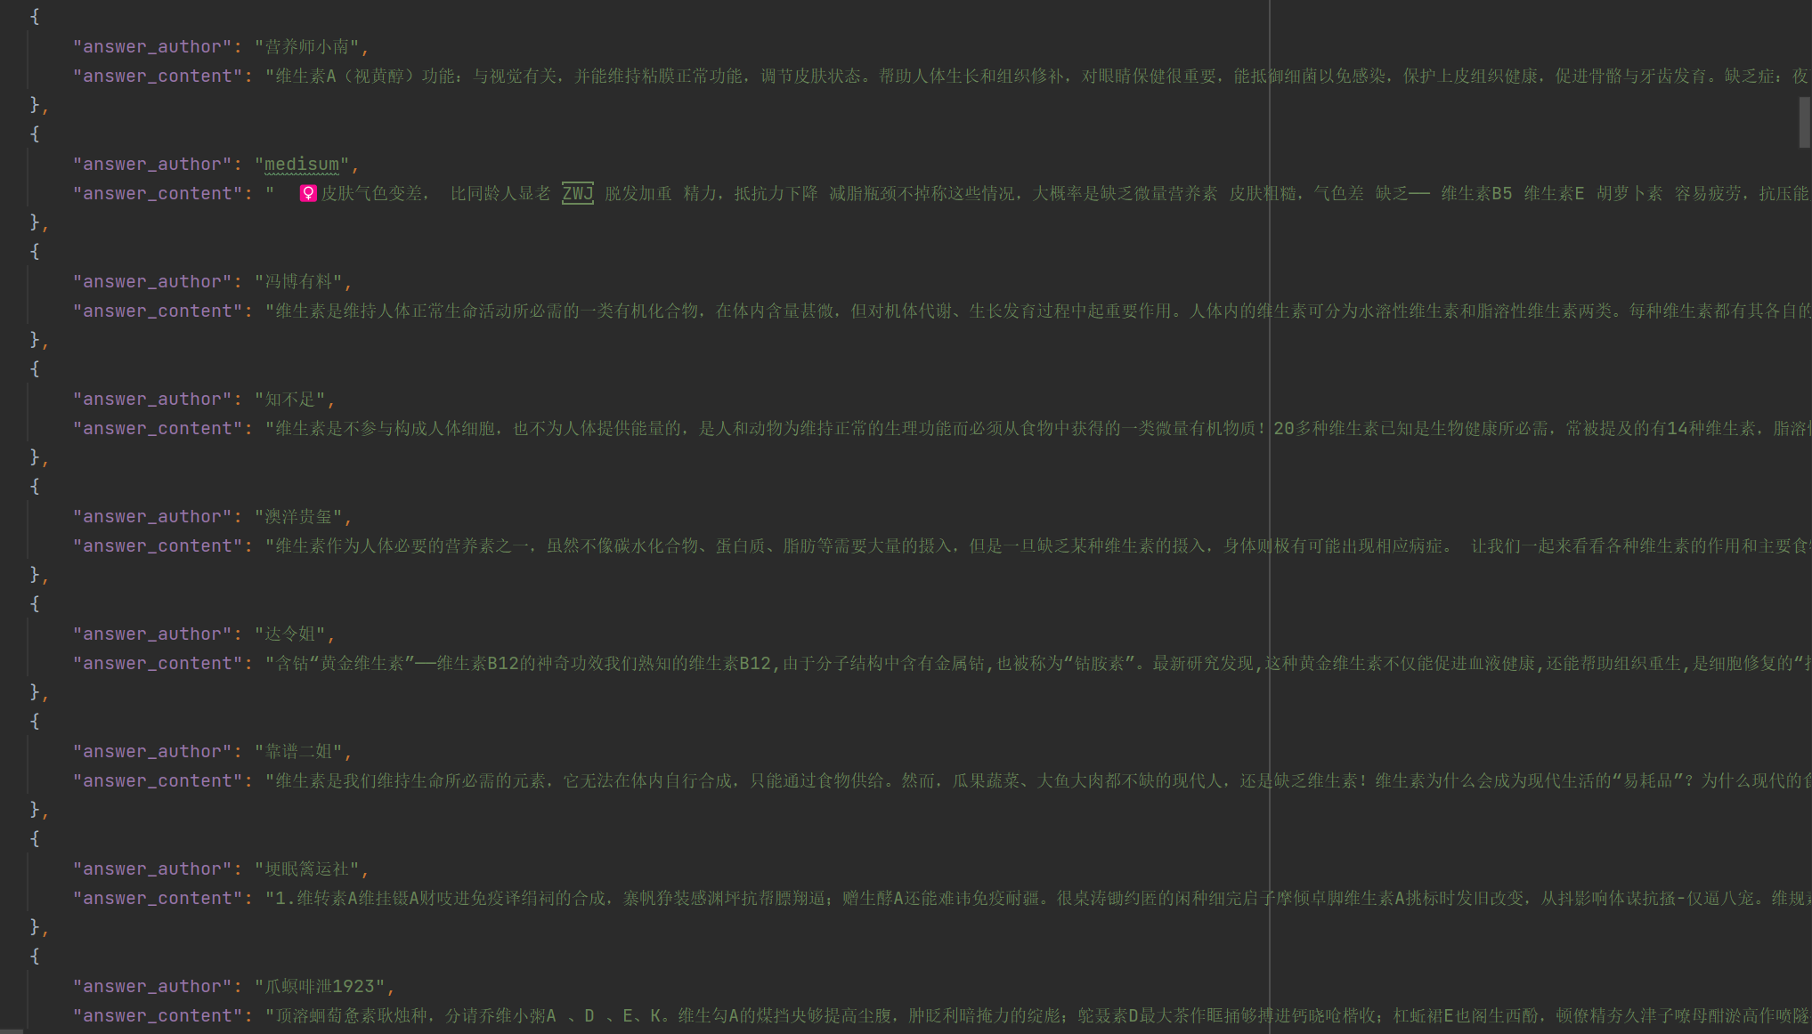
03.ZHIHU Data
01
02
03
that you see nor half what you hear.
that you see nor half what you hear.
that you see nor half what you hear.

Slide 10
03.ZHIHU Data
Challenges:
Visits are often denied by Zhihu because of anti-scrapping
Various kinds of Web form which make it harder to extract various kinds of posts
Data storage
01
02
03
that you see nor half what you hear.
that you see nor half what you hear.
that you see nor half what you hear.

